Slide 1
History of Sciences

Slide 2
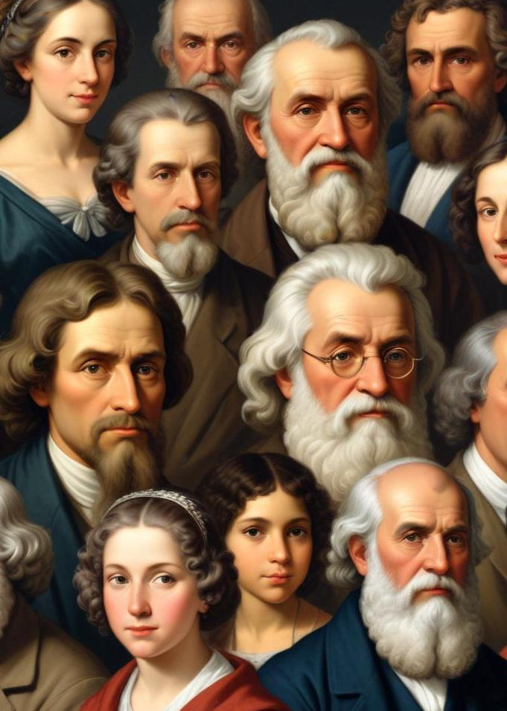
Introduction
This presentation explores the vast history of science through influential figures and their contributions. From ancient philosophers to modern scientists, each has shaped our understanding of the world.

Slide 3
01
Ancient Science

Slide 4
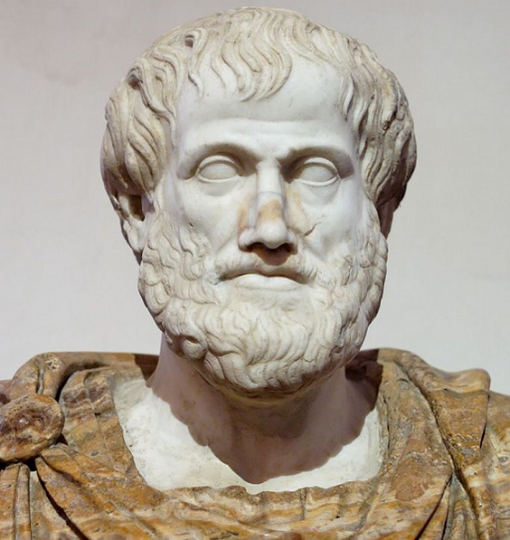
Aristotle's Contributions
Aristotle, a key figure in many sciences, advanced biology, physics, and metaphysics. His work shaped natural philosophy and scientific inquiry through observation and research.

Slide 5
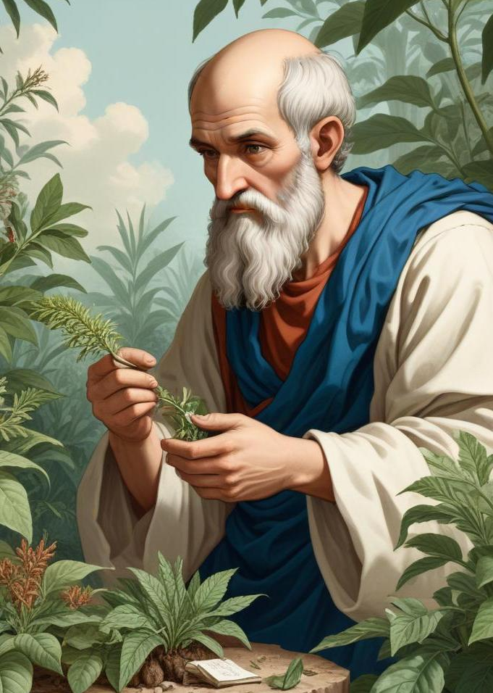
Theophrastus and Botany
Theophrastus, often called the 'father of botany', succeeded Aristotle and expanded the study of plants. His works categorized plants based on their properties, significantly influencing botanical science and taxonomy.

Slide 6
Influence on Later Scientists
Aristotle and Theophrastus influenced scholars in the Renaissance and Enlightenment, shaping modern science. Their works were studied for centuries, inspiring future generations.

Slide 7
02
Medieval Science

Slide 8
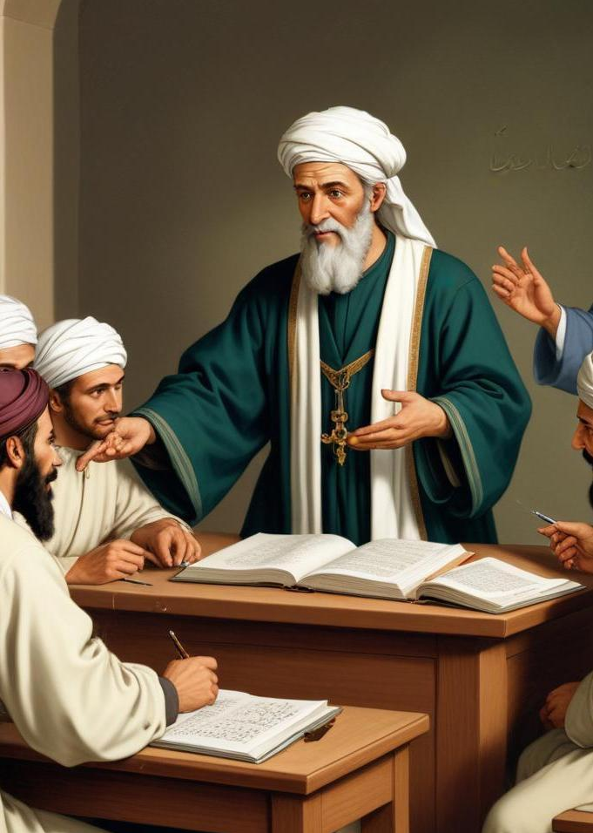
Avicenna's Medical Texts
Avicenna, a Persian scholar, wrote The Canon of Medicine, combining ancient knowledge with his own insights. His work became a key reference in both Western and Islamic medicine for centuries, focusing on diagnosis and treatments.

Slide 9
Philosophy of Science
In the medieval period, scholars started studying the philosophy of science, focusing on the nature and limits of knowledge. Thinkers like Avicenna looked at how evidence and reasoning work together, paving the way for future ideas.

Slide 10
03
Early Modern Science

Slide 11
Vesalius and Anatomy
Andreas Vesalius revolutionized the study of human anatomy with his work 'De humani corporis fabrica'. He conducted detailed dissections that contradicted previous notions from Galen and provided accurate illustrations. His emphasis on empirical observation and detailed anatomical drawings marked a turning point in medical education and practice.

Slide 12
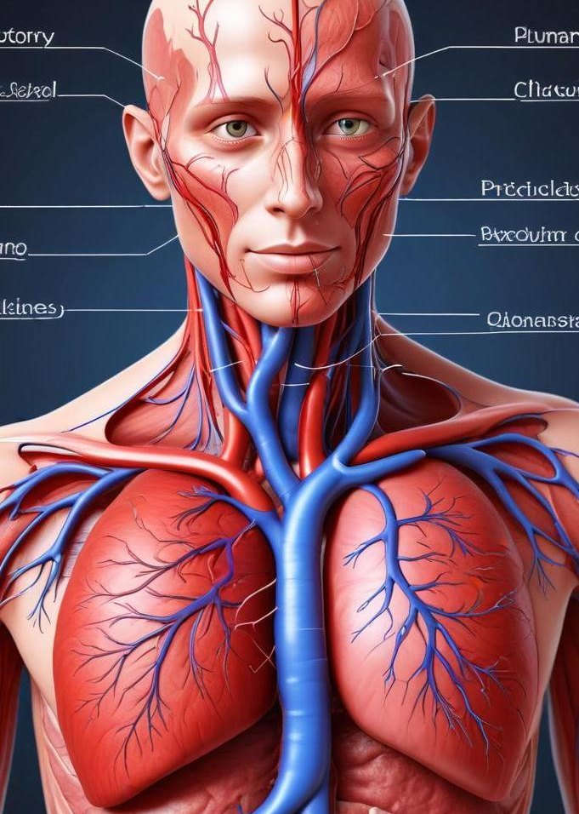
Harvey's Circulatory System
William Harvey discovered the circulation of blood in the human body, detailing how the heart pumps blood through arteries and veins in his work 'De motu cordis'. His findings challenged established beliefs and laid the foundation for modern physiology and the understanding of blood circulation.

Slide 13
Hooke's Micrographia
Robert Hooke's 'Micrographia' introduced the world to the microscopic realm, showcasing detailed sketches of small organisms and plant structures. His observations led to the formulation of the cell theory, introducing the term 'cell' to describe the basic unit of life and inspiring future research in microbiology.

Slide 14
04
Evolutionary Biology

Slide 15
Lamarck's Theories
Jean-Baptiste de Lamarck proposed the first comprehensive theory of evolution which suggested that organisms evolve through inheritance of acquired characteristics. Although later debunked, his ideas sparked discussion on the mechanisms of evolution, paving the way for later theories.

Slide 16
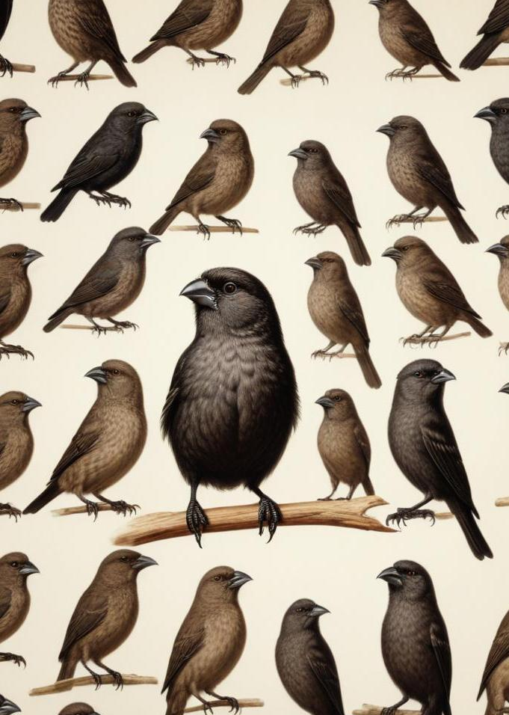
Darwin's Natural Selection
Charles Darwin formulated the theory of natural selection, explaining how species adapt and evolve over time based on environmental pressures and survival advantages. His landmark work 'On the Origin of Species' fundamentally altered the understanding of biology and the connections among living organisms.

Slide 17
Mendel's Genetics
Gregor Mendel established the principles of inheritance through his experiments with pea plants. He discovered dominant and recessive traits, laying the groundwork for modern genetics. His work remained largely unrecognized until the early 20th century, influencing our understanding of heredity.

Slide 18
05
Modern Contributions

Slide 19
Pasteur and Germ Theory
Louis Pasteur's experiments disproved the theory of spontaneous generation and provided critical evidence for germ theory, showing that microorganisms cause disease. His work led to advancements in hygiene, vaccination, and the practice of pasteurization, impacting public health significantly.

Slide 20
Watson and Crick's DNA Model
James Watson and Francis Crick elucidated the double helix structure of DNA, revolutionizing the understanding of genetics. Their model explained how genetic information is stored and transmitted, impacting molecular biology and genetics profoundly, leading to advancements in various fields, including medicine and forensics.

Slide 21
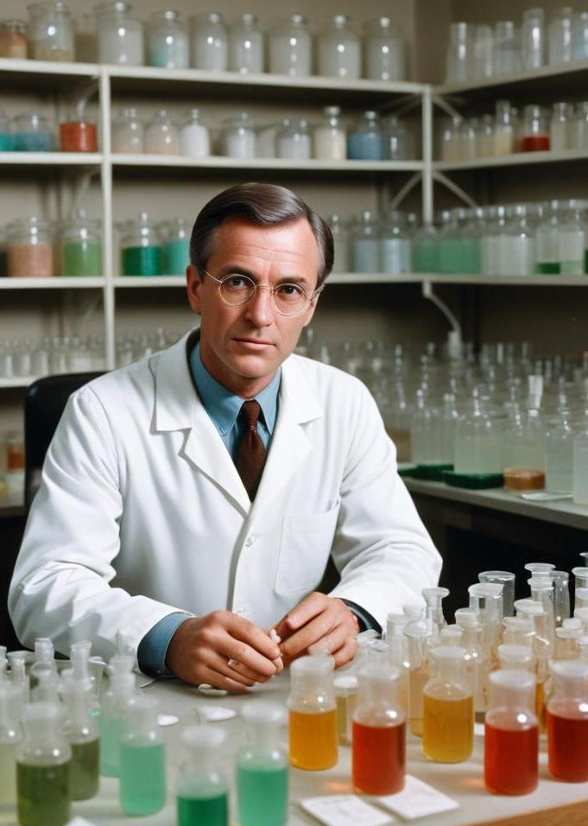
Fleming and Antibiotics
Alexander Fleming discovered penicillin, the first true antibiotic, which revolutionized medicine by providing an effective treatment for bacterial infections. His discovery transformed healthcare, significantly decreasing mortality rates and paving the way for antibiotic therapy in modern medicine.

Slide 22
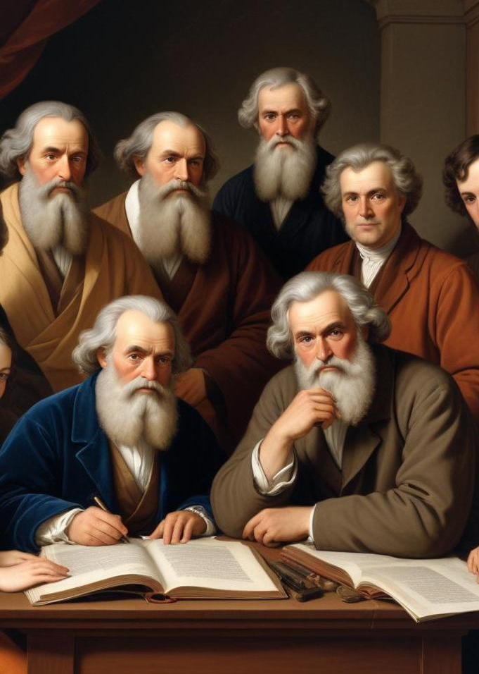
Conclusions
The history of science is marked by the contributions of many individuals whose work has shaped our understanding of the world. From ancient philosophers to modern scientists, their discoveries and theories have built a foundation for current scientific knowledge.

Slide 23
To do :
Create a digital timeline of great scientists. You can add more scientists, but the timeline must show the period they lived in and their major discovery.

